Slide 1
Bank Management System
A project by HARMAN,AKASH & Surya

Slide 2

Aim
To develop a bank management system for solving financial applications of a customer in banking environment in order to nurture the needs of an end banking user by providing various ways to perform banking tasks.

Slide 3


Problem Description
The bank management system is an application for maintaining a person’s account in a bank. The system provides the access to the customer to create an account, deposit/withdraw the cash from his account, also to view reports of all accounts present. The following presentation provides the specification for the system.

Slide 4
BENEFITS
Provide flexibility
For better performance.
Reducing man power.
For doing work more accurately. Faster performance.

Slide 5
LANGUAGE USED: C++
THE C++ CODE USED FOR BANKING MANAGEMENT SYSTEM, INCLUDES STRUCTURE

Slide 6

MODULES
NEW ACCOUNT:
Opens a new account for the user by accepting input such as given name, family name , intial amount to be deposit.

Slide 7
DEPOSIT AMOUNT
Provides options to deposit amount from the given account number .
WITHDRAW
Provides options to withdraw amount from the given account number.
.

Slide 8

BALANCE ENQUIRY
Displays the list of a customer’s account details comprising of account number, name and balance amount.
Tip
If one example isn’t sufficient to help people understand the breadth of your idea, pick a couple of examples.
Story for illustration purposes only

Slide 9

DISPLAY THE LIST OF ALL CLIENTS
Displays the list of all customer’s account details comprising of account number, .

Slide 10
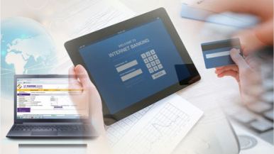
DISPLAY THE AVERAGE BALANCE OF ALL ACCOUNT
This is used by bank administration to check average worth of clients
DISPLAY THE TOTAL BALANCE VALUE OF ALL THE ACCOUNT
This is used by administration to to check cash value of the bank,and performance of bank, and acquisition of bank.

Slide 11

TRANSACTION HISTORY
System allows to users to check statement of the account.

Slide 12
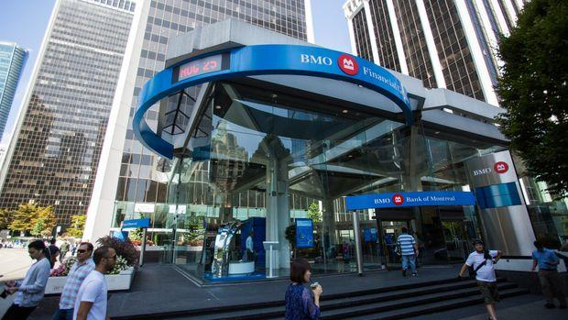
SNAPSHOTS

Slide 13

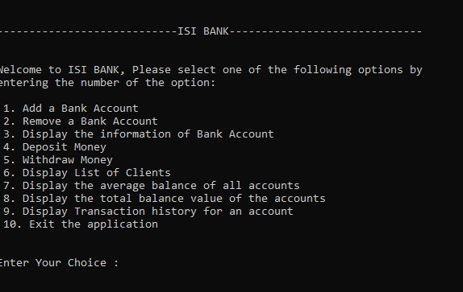

HOME PAGE
Tip
When a number is too large or too small to easily comprehend, clarify it with a comparison to something familiar.
Source: travel.trade.gov

Slide 14
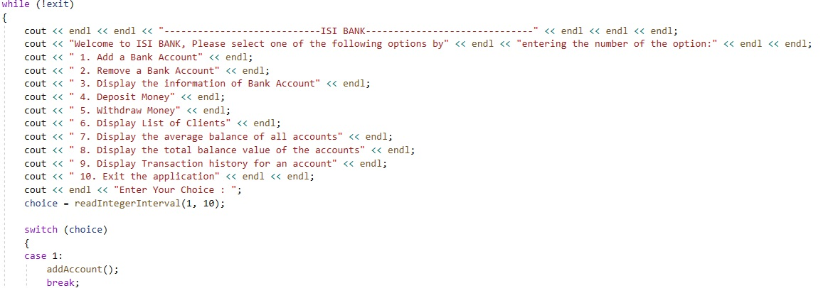
HOME PAGE
Tip
When a number is too large or too small to easily comprehend, clarify it with a comparison to something familiar.
Source: travel.trade.gov

Slide 15
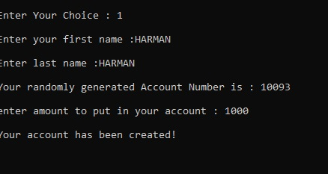
CREATING AN ACCOUNT
Tip
When a number is too large or too small to easily comprehend, clarify it with a comparison to something familiar.
Source: travel.trade.gov

Slide 16
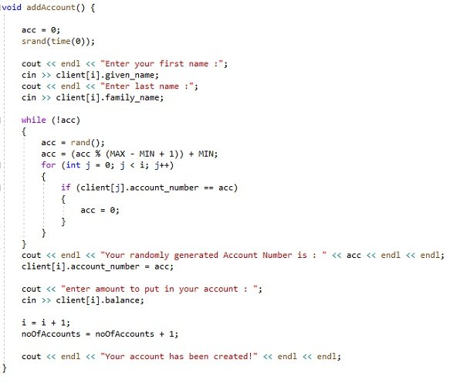
CREATING AN ACCOUNT
Tip
When a number is too large or too small to easily comprehend, clarify it with a comparison to something familiar.
Source: travel.trade.gov

Slide 17
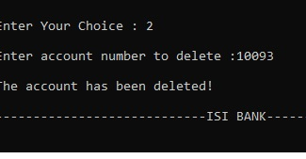
DELETING AN ACCOUNT
Tip
When a number is too large or too small to easily comprehend, clarify it with a comparison to something familiar.
Source: travel.trade.gov

Slide 18
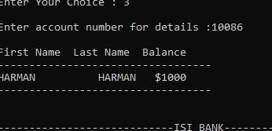
ACCOUNT INFORMATION
Tip
When a number is too large or too small to easily comprehend, clarify it with a comparison to something familiar.
Source: travel.trade.gov

Slide 19
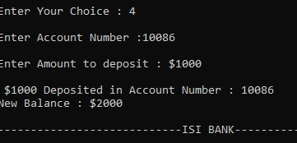
DEPOSIT AMOUNT
Tip
When a number is too large or too small to easily comprehend, clarify it with a comparison to something familiar.
Source: travel.trade.gov

Slide 20
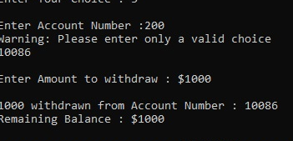
WITHDRAWAL FROM ACCOUNT
Tip
When a number is too large or too small to easily comprehend, clarify it with a comparison to something familiar.
Source: travel.trade.gov

Slide 21
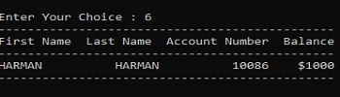
DISPLAY ALL OPEN ACCOUNTS IN BANK

Slide 22
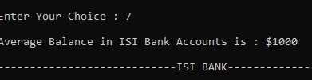
DISPlLAY THE AVERAGE BALANCE OF ALL ACCOUNT IN THE BANK
Tip
When a number is too large or too small to easily comprehend, clarify it with a comparison to something familiar.
Source: travel.trade.gov

Slide 23
DISPLAY ALL OPEN ACCOUNTS IN BANK

Slide 24
DISPLAY THE AVERAGE BALANCE OF ALL ACCOUNT IN THE BANK
Tip
When a number is too large or too small to easily comprehend, clarify it with a comparison to something familiar.
Source: travel.trade.gov

Slide 25

DISPLAY THE TOTAL BALANCE OF ALL ACCOUNT IN THE BANK
Tip
When a number is too large or too small to easily comprehend, clarify it with a comparison to something familiar.
Source: travel.trade.gov

Slide 26
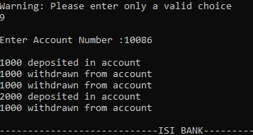
DISPLAY THE TRANSACTION HISTORY OF AN ACCOUNT

Slide 27
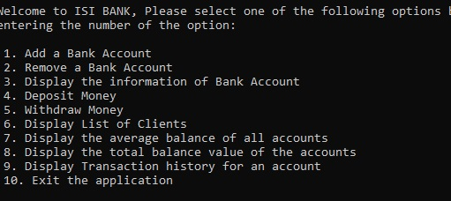
LOGOUT FROM SYSTEM BY ENTERING NO 10

Slide 28
Milestones
23 NOVEMBER 2020
3 December 2020
30 NOV 2020
7 December 2020
REQUIREMENT GATHERING, MODULES TO BE USED LIKE STRUCT
Prototype build, validation and fixing some logics that cause errors
November 2020 |  |  |  | December 2020
Translate logics TO programming language
Project build. Did some documentation.

Slide 29
THANK YOU

